Slide 1
OpenPET software GUI design schemes
Qiyu Peng

Slide 2
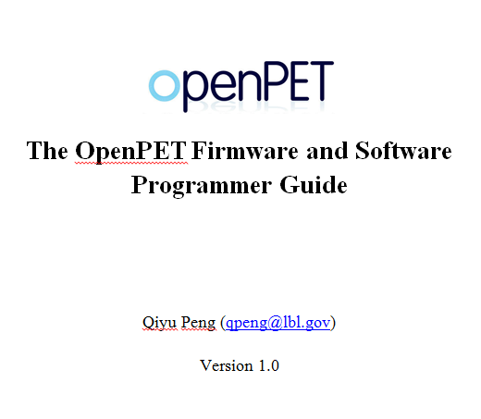

Slide 3
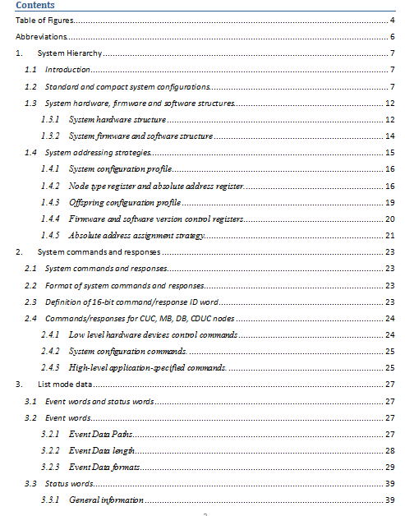

Slide 4
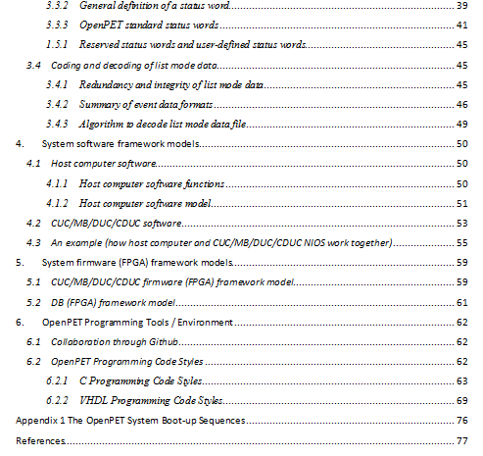

Slide 5
Programming Tools / Environment
 | DB | DUC | MB | CUC | Host PC
FPGA Firmware | X | X | X | X
Embedded MCU Software (NIOS) |  | X | X | X
PC Software |  |  |  |  | X
X: VHDL (Altera Quartus II ver. 12.0)
X: C (Altera Nios II EDS ver. 12.0)
X: C (NI LabWindows CVI 2009)

Slide 6
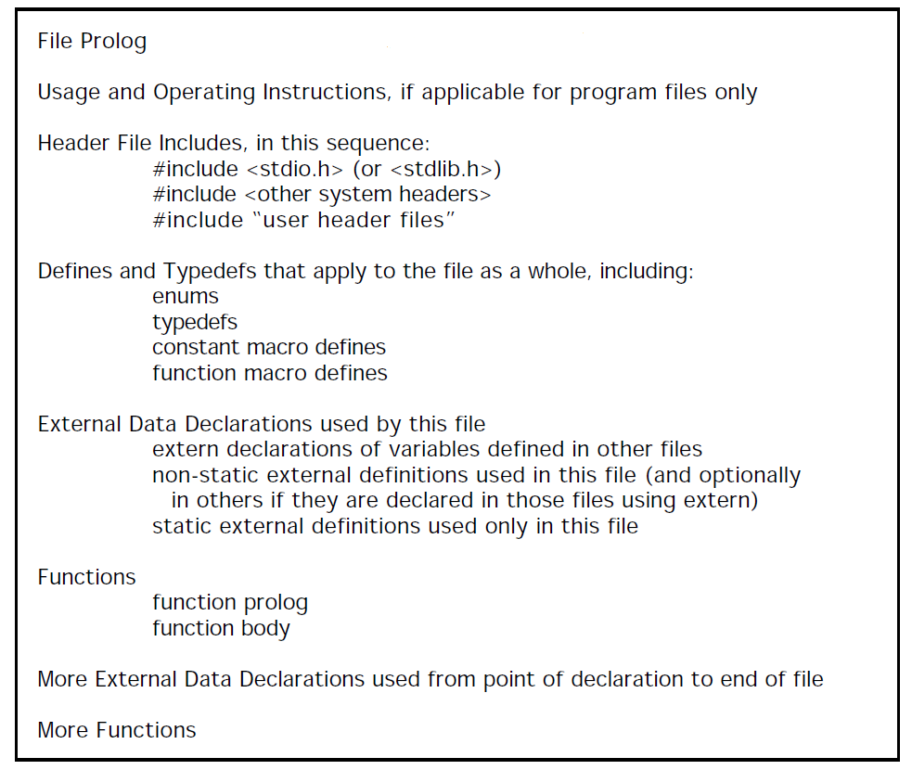
C programing style guidelines
Rules and guidelines are used to guarantee the readability and maintainability of the C source codes (details are in my word file)
Based on “C Style Guide” suggested by Software Engineering Laboratory (SEL), the National Aeronautics and Space Administration (NASA) in 1994.

Slide 7
Host PC software
Modular Design
Simple and easy to use
Upgradable
Main Functions
System configuration and system diagnosis
Data acquisition
Data analysis

Slide 8
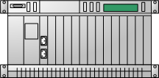

Software Requirement Analysis
System calibration and characterization
(control console and scripts)
System configuration and test
(GUI and scripts)
DAQ configuration and DAQ
(GUI and scripts)
Data analysis and visualization
(GUI and scripts)
System configuration database
List mode data (with a head file)
List mode data (with a head file)
Data analysis reports
System HW/FW
System HW/FW

Slide 9
Head file format
File name
Date and time
Data type
Data collection time
Software version
Firmware version
User defined comments

Slide 10
Event words and status words
In general, there are two kinds of words in the OpenPET list mode data:
Event words, include
-- Single event words, and
-- Coincidence
Status words transmit information other than the event data to the host PC, such as:
-- Event data format
-- Time information
-- Single or coincidence event rate
-- System configuration and status
-- Application-specific information such as patient bed position, transmission source position, system temperature, ECG signal, gate signal and etc.

Slide 11
Event words
Event word path
Add 3-bit MB address to single event data.
Generate coincidence event data (optional).
Insert status words to the data stream.
Generate original single event data
Add 3-bit DB
address to the
single event data
Add 3-bit DUC
address to the
single event data
Host PC
DB
DUC
MB
CUC
Add 3-bit DB address to single event data.
Generate coincidence event data (optional).
Insert status words to the data stream.
Generate original single event data
Host PC
DB
CDUC
Add 3-bit DUC address to single event data.
Generate coincidence event data (optional).
Insert status words to the data stream.
Generate original single event data
Add 3-bit DB
address to the
single event data
Host PC
DB
DUC
CUC

Slide 12
Event data length
Data from DB→DUC, DUC→ MB and MB→CUC
Single event data only
32-bit mode or 64-bit mode.
Data from CUC → host PC
Single event data, coincidence event data and status words.
32-bit mode, 64-bit mode, and 128-bit mode.

Slide 13
Data paths and data mode combinations
32 bits
32 bits
32 bits
32 bits
DB
DUC
MB
CUC
Host PC
8 system clocks
32 bits
32 bits
32 bits
64 bits
DB
DUC
MB
CUC
Host PC
64 bits
64 bits
64 bits
64 bits
DB
DUC
MB
CUC
Host PC
16 system clocks
64 bits
64 bits
64 bits
128bits
DB
DUC
MB
CUC
Host PC
Oscilloscope mode

Slide 14
DB→DUC, DUC→ MB and MB→CUC
32-bit data (8 system clocks)
General definition
1
MB address
DUC address
DB address
Block address
Crystal ID
31
30
29
28
27
26
25
24
23
22
21
20
19
18
17
16
Crystal ID
Payload
15
14
13
12
11
10
9
8
7
6
5
4
3
2
1
0

Slide 15
DB→DUC, DUC→ MB and MB→CUC
32-bit mode (8 system clocks)
Payload definition
-- Time mode – Bit 10~0, TDC data bits (11 bits, LSB: 50ps).
-- Energy mode – Bit 10~0, energy data bits (11 bits).
-- Test mode1 – Bit 10~0, test pattern data: 10101010101.
-- Test mode2 – Bit 10~0, test pattern data: 01010101010.
-- Anger-logic flood map plot mode – Bit 18, not used,
Bit 17~9, Y value (9 bits), Bit 8~0, X value (9 bits).
-- User-defined mode 1 - 11 bits of payload
-- User-defined mode 2 - 14 bits of payload
-- User-defined mode 3 - 17 bits of payload
-- User-defined mode 4 - 22 bits of payload
-- User-defined mode 5 - 25 bits of payload
-- User-defined mode 6 - 28 bits of payload
Standard
User-defined

Slide 16
DB→DUC, DUC→ MB and MB→CUC
32-bit mode (Oscilloscope mode)
General definition
1
MB address
DUC address
DB address
Channel address
Unused
31
30
29
28
27
26
25
24
23
22
21
20
19
18
17
16
Data counter
Raw ADC data
15
14
13
12
11
10
9
8
7
6
5
4
3
2
1
0
The maximum length of the raw data train is 64

Slide 17
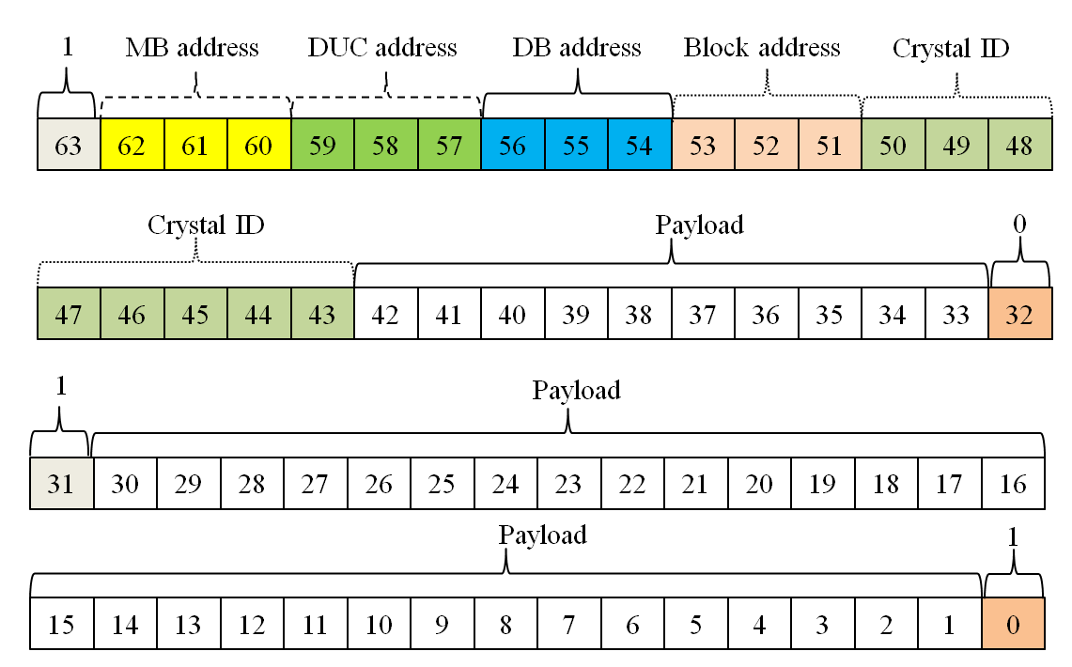
DB→DUC, DUC→ MB and MB→CUC
64-bit data (16 system clocks)
General definition

Slide 18
DB→DUC, DUC→ MB and MB→CUC
32-bit mode (8 system clocks)
Payload definition
-- Time mode – Bit 10~0, TDC data bits (11 bits, LSB: 50ps).
-- Energy mode – Bit 10~0, energy data bits (11 bits).
-- Test mode1 – Bit 10~0, test pattern data: 10101010101.
-- Test mode2 – Bit 10~0, test pattern data: 01010101010.
-- Anger-logic flood map plot mode – Bit 18, not used,
Bit 17~9, Y value (9 bits), Bit 8~0, X value (9 bits).
-- User-defined mode 1 - 11 bits of payload
-- User-defined mode 2 - 14 bits of payload
-- User-defined mode 3 - 17 bits of payload
-- User-defined mode 4 - 22 bits of payload
-- User-defined mode 5 - 25 bits of payload
-- User-defined mode 6 - 28 bits of payload
Standard
User-defined

Slide 19
CUC → host PC
Single event mode
In single event data mode (including the 32-bit raw ADC data mode), the formats of the data from CUC/CDUC→ host PC are the exactly the same that those defined in previous section (DB→DUC, DUC→ MB and MB→CUC).

Slide 20
CUC → host PC
Coincidence event mode
Two 32-bit single event data → one 64-bit coincidence event data
Two 64-bit single event data → one 128-bit coincidence event data
Two 32-bit single event data → one 32-bit coincidence event data
Two 64-bit single event data → one 64-bit coincidence event data
1
MB address
DUC address
DB address
Block address
Crystal ID
63
62
61
60
59
58
57
56
55
54
53
52
51
50
49
48
Single Event 1
Crystal ID
Payload
47
46
45
44
43
42
41
40
39
38
37
36
35
34
33
32
Valid
MB address
DUC address
DB address
Block address
Crystal ID
31
30
29
28
27
26
25
24
23
22
21
20
19
18
17
16
Single Event 2
Crystal ID
Payload
15
14
13
12
11
10
9
8
7
6
5
4
3
2
1
0

Slide 21
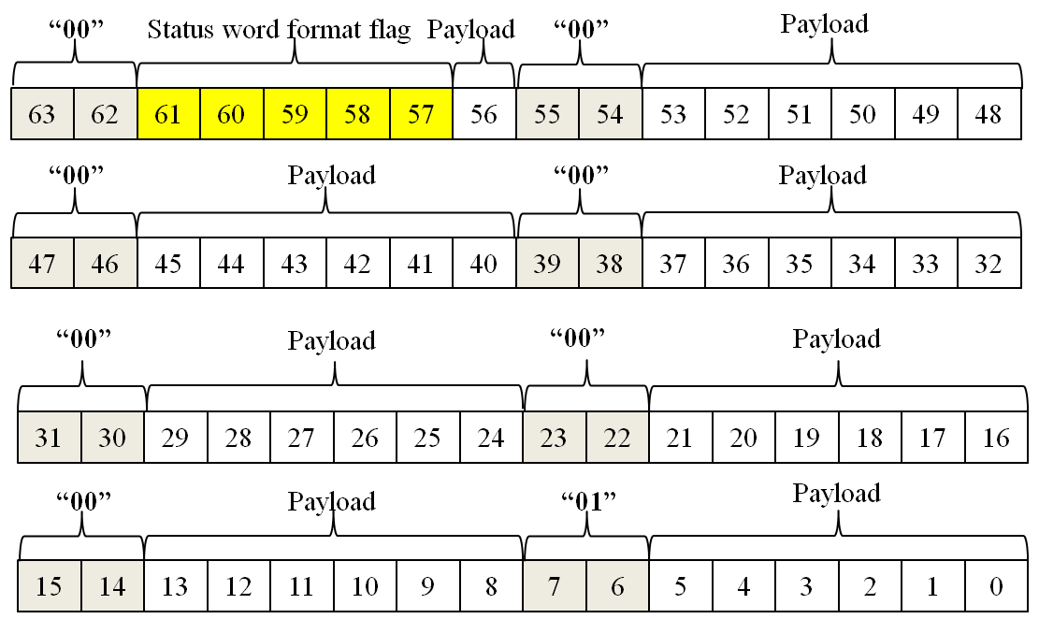
Status word (fixed to 64 bits)
General definition

Slide 22
Decoding List Mode Binary Data

Slide 23
Data In
Status word
Event word
Single Event
Coincidence event
Raw ADC
32-bit
64-bit
32:32
32:64
64:64
64:128
Event data format / Timer
Single event rate
Coincidence event rate

Slide 24
Algorithm to decode list mode data file
Start
Read 8 bytes of data
Check the two MSB of the 8 bytes of data
Find pattern “00”, …, “01”?
No
Yes
No
An event format status word (00000)?
Yes
Determine the event data format
End

Slide 25
Status Words
Provide ancillary information
Format
64 bits marked by “00” beginning each byte
Last byte begins “01”
Format flag indicates type of word
Payload contains data
64-bit status word

Slide 26
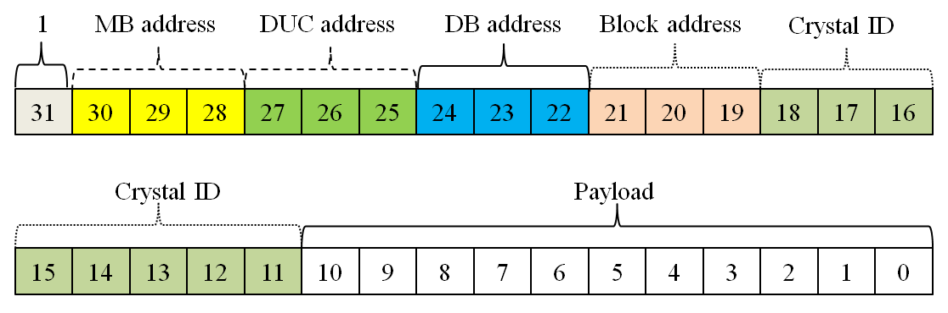
Event Words
Raw ADC
32 bits
Single event
32 or 64 bits
Coincidence event
32, 64, or 128 bits
Format
Most-significant bit always “1”
Ex. 32-bit single event word

Slide 27
Data In
Status word
Event word
Single Event
Coincidence event
Raw ADC
32-bit
64-bit
32:32
32:64
64:64
64:128
Event data format / Timer
Single event rate
Coincidence event rate

Slide 28
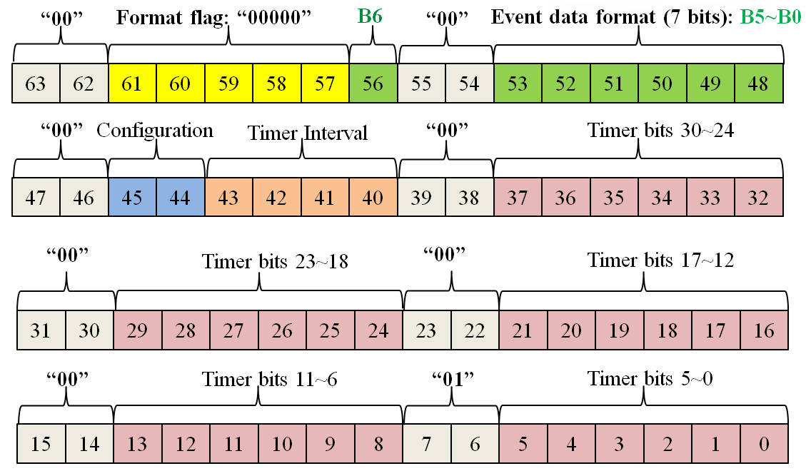
Status Word – Event data format / Timer
Bit 63-62, 55-55, 47-46, 39-38, 31-30, 23-22, 15-14: “00”
Bits 7-6: “01”
Bit 61-57: status word type – format/timer word = “00000”
Bit 56: single or coincidence
Bits 53-48: event word type (i.e. raw ADC)
Bits 45-44: system config (i.e. small config)
Bits 43-40: status word frequency (i.e. every 1 ms)
Remaining 30 bits: timer
Event data format / Timer word

Slide 29
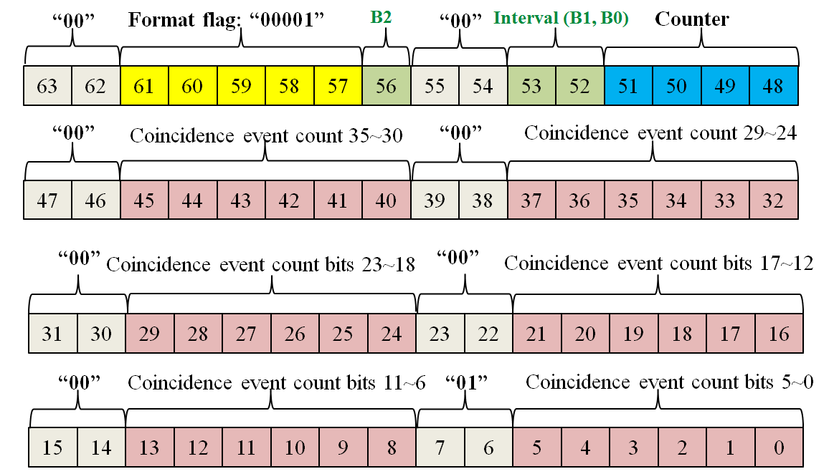
Status Word – Coincidence event rate
Bit 63-62, 55-55, 47-46, 39-38, 31-30, 23-22, 15-14: “00”
Bits 7-6: “01”
Bit 61-57: status word type – coincidence rate word = “00001”
Bit 56,53,52: status word frequency (i.e. every 1 sec)
Bits 51-48: coincidence event rate status word counter
Remaining 36 bits: coincidence event counter
Coincidence event rate word

Slide 30
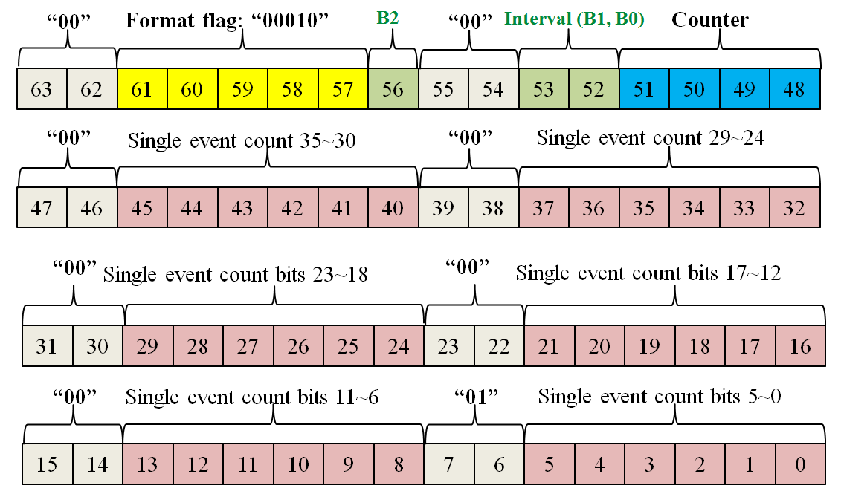
Status Word – Single event rate
Bit 63-62, 55-55, 47-46, 39-38, 31-30, 23-22, 15-14: “00”
Bits 7-6: “01”
Bit 61-57: status word type – single event rate word = “00010”
Bit 56,53,52: status word frequency (i.e. every 1 sec)
Bits 51-48: single event rate status word counter
Remaining 36 bits: single event counter
Single event rate word

Slide 31
Data In
Status word
Event word
Single Event
Coincidence event
Raw ADC
32-bit
64-bit
32:32
32:64
64:64
64:128
Event data format / Timer
Single event rate
Coincidence event rate

Slide 32
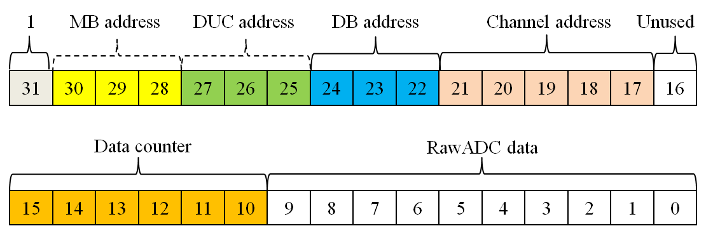
Single Event - Raw ADC
Bit 31: “1”
Bits 30-17: address
Bit 16: unused
Bits 15-10: 64-level counter to create ADC train
Bits 9-0: raw ADC data
32-bit raw ADC data
64 raw ADC data points form 1 single event curve

Slide 33
Single Event – 32-bit data
Bit 31: “1”
Bits 30-11: address
Bits 10-0: payload data
Time mode, energy mode, test mode, flood map mode, user-defined mode
32-bit single event data

Slide 34
Single Event – 64-bit data (not recommended)
Bit 63: “1”
Bit 32: “0”
Bit 31: “1”
Bit 0: “1”
Bits 62-43: address
Bits 42-33,30-1: payload data
64-bit single event data

Slide 35
Data In
Status word
Event word
Single Event
Coincidence event
Raw ADC
32-bit
64-bit
32:32
32:64
64:64
64:128
Event data format / Timer
Single event rate
Coincidence event rate

Slide 36
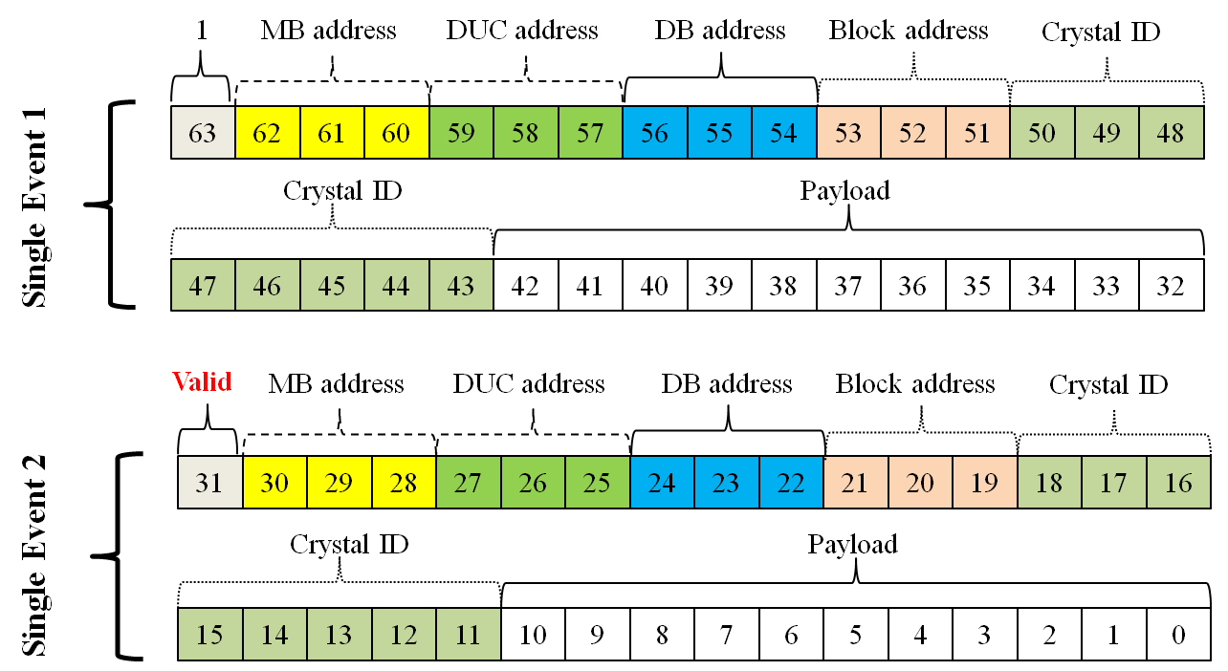
Coincidence event – 32-bit → 64-bit
Two 32-bit single event words
Bit 31: set to 1 if valid coincidence data; 0 if not
32→64-bit coincidence event data

Slide 37
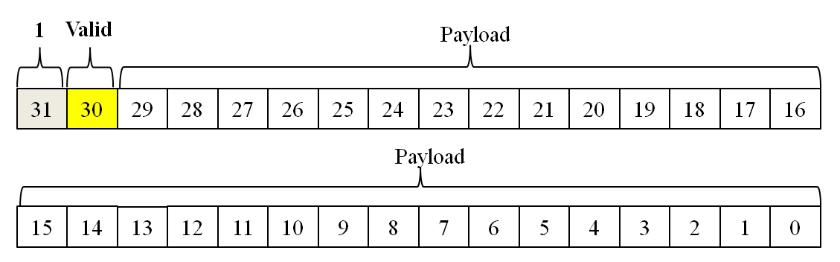
Coincidence event – 32-bit → 32-bit
Bit 31: “1”
Bit 30: set to 1 if valid coincidence data; 0 if not
Bits 29-0: determined by user (i.e. coincidence pair ID and time differential)
32→32-bit coincidence event data

Slide 38
Coincidence event – 64-bit → 128-bit
Two 64-bit single event words
Bit 63: set to 1 if valid coincidence data; 0 if not
64-bit single event data

Slide 39
Coincidence event – 64-bit → 64-bit
Bit 63: “1”
Bit 62: set to 1 if valid coincidence data; 0 if not
Bits 61-0: determined by user (i.e. coincidence pair ID and time differential)

Slide 40
Data In
Status word
Event word
Single Event
Coincidence event
Raw ADC
32-bit
64-bit
32:32
32:64
64:64
64:128
Event data format / Timer
Single event rate
Coincidence event rate

Slide 42
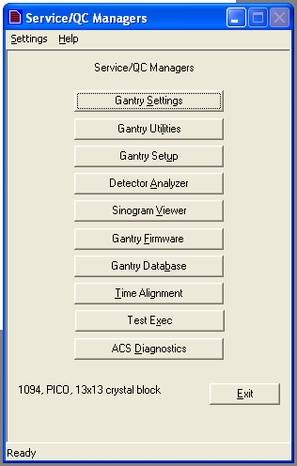
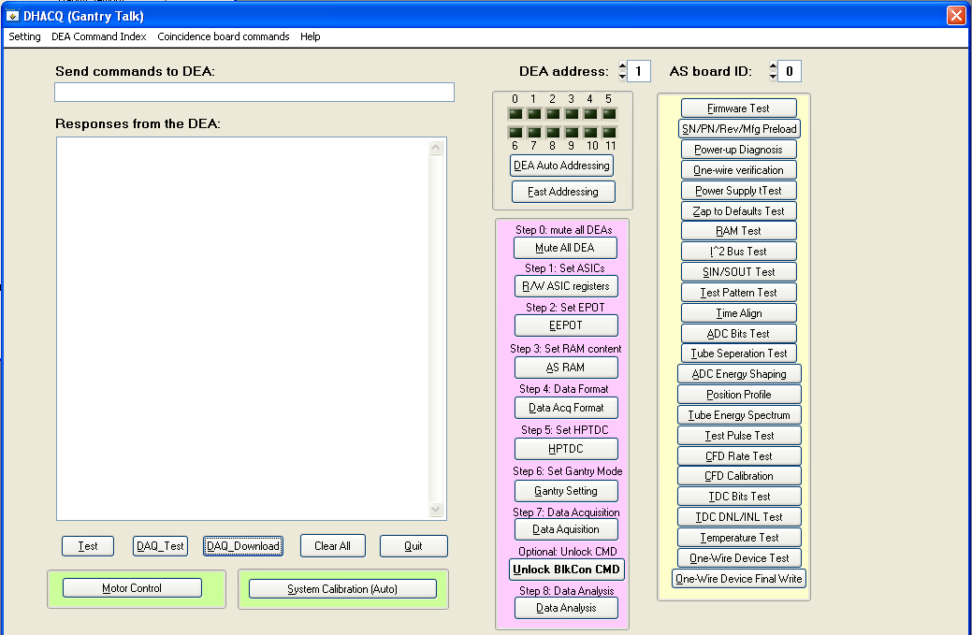
Graphical User Interface (GUI) design
Top level design

Slide 43
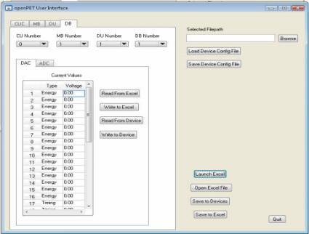
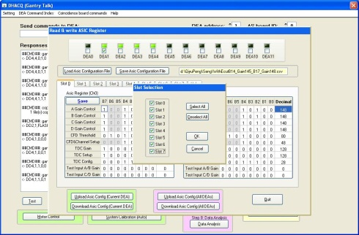
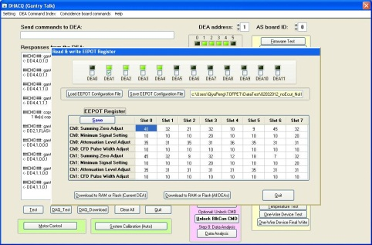
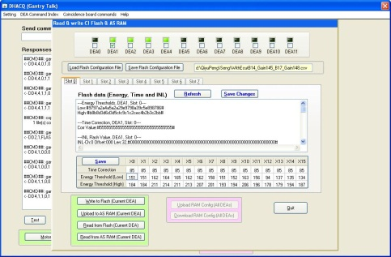
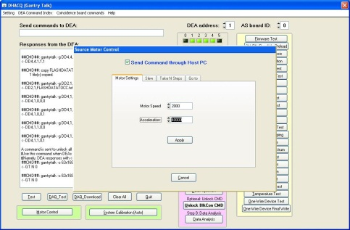
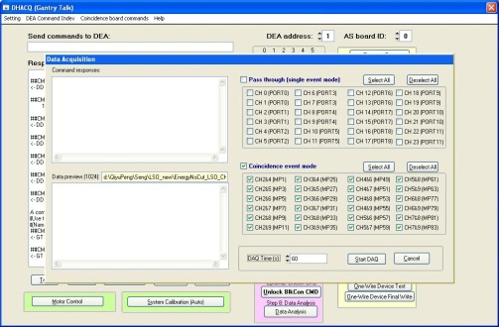
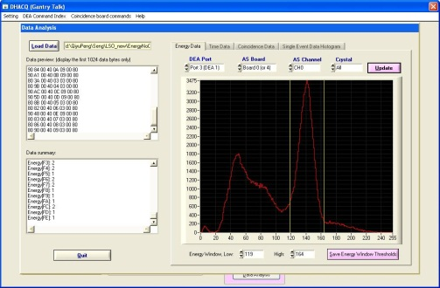
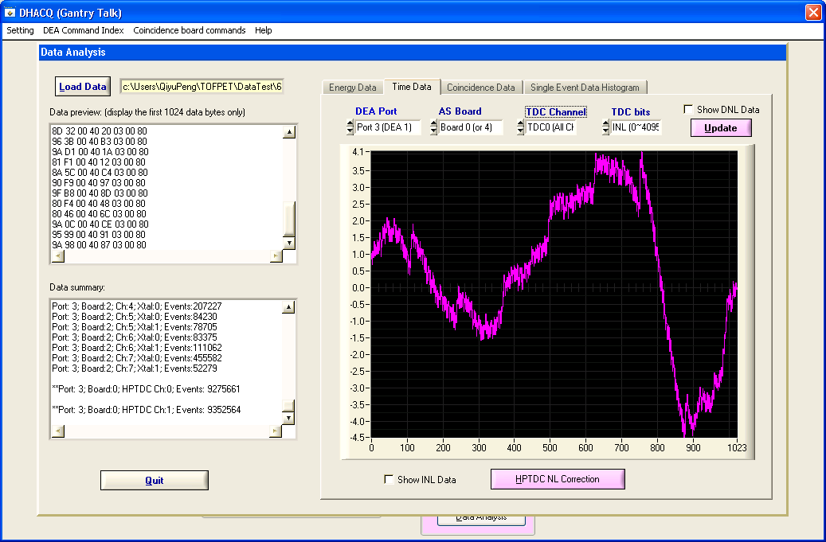
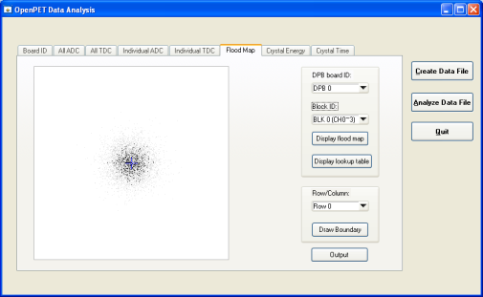
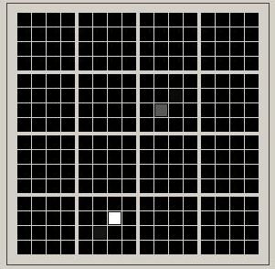
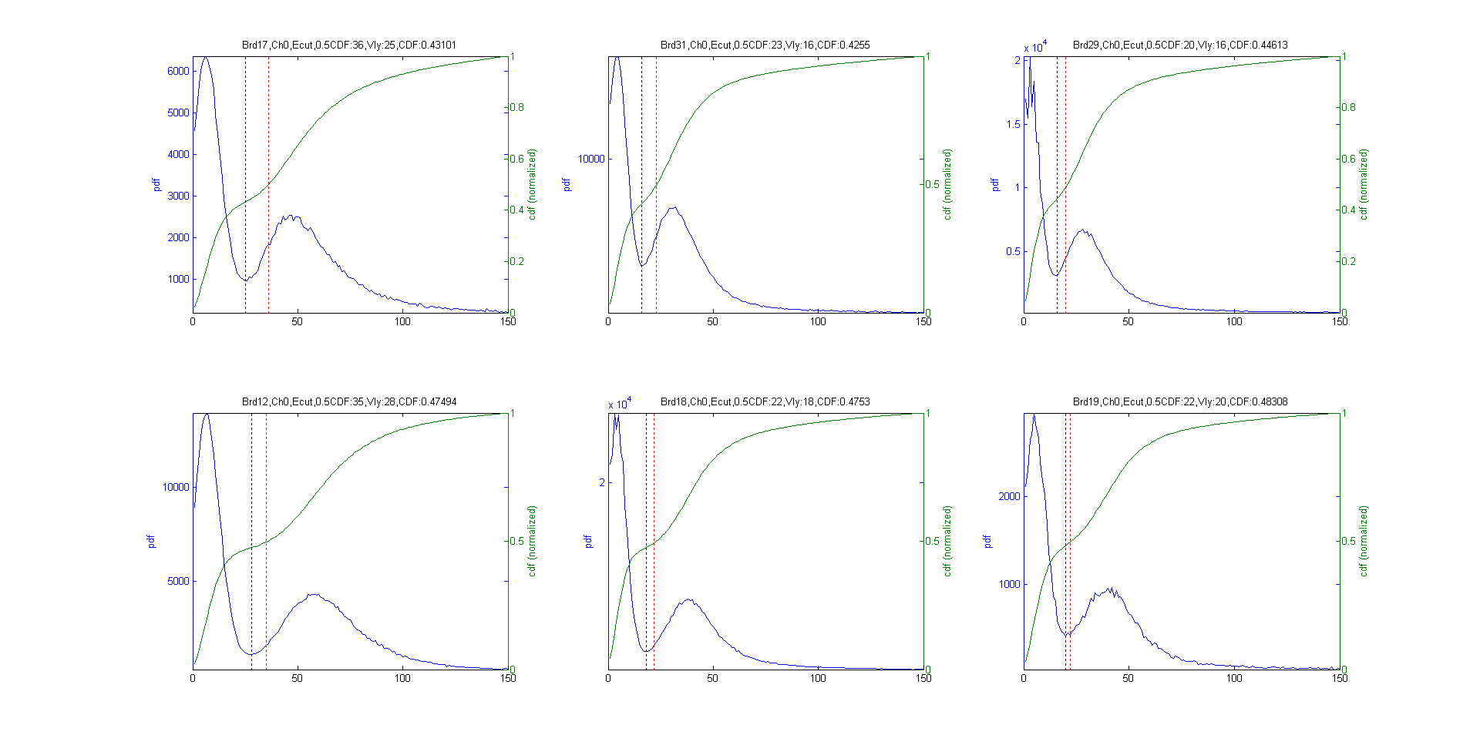
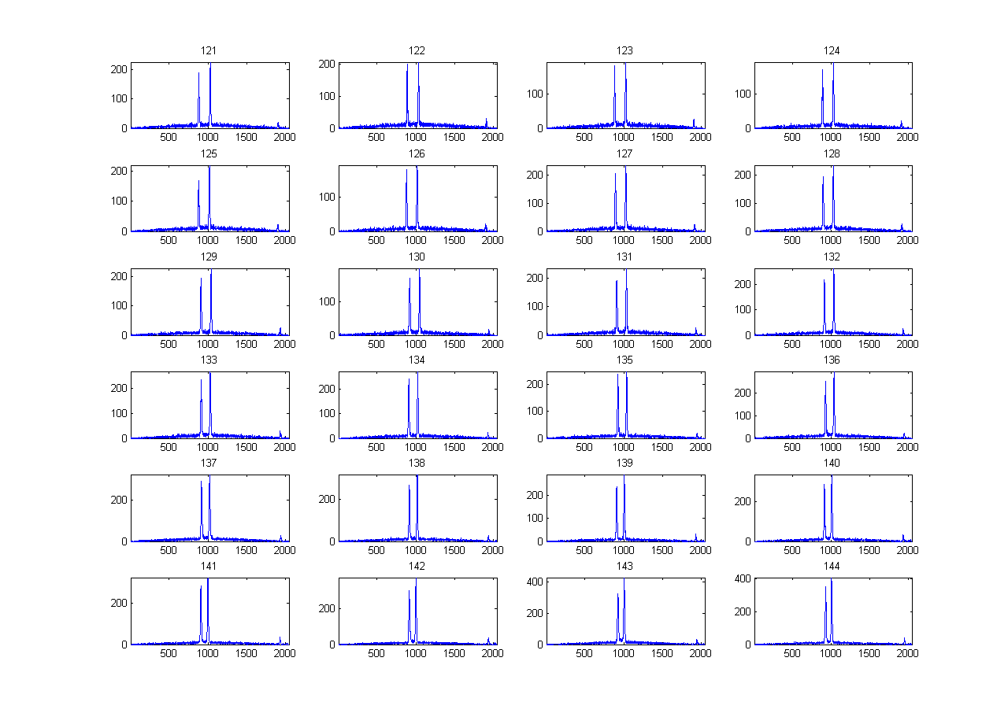
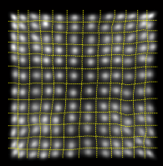
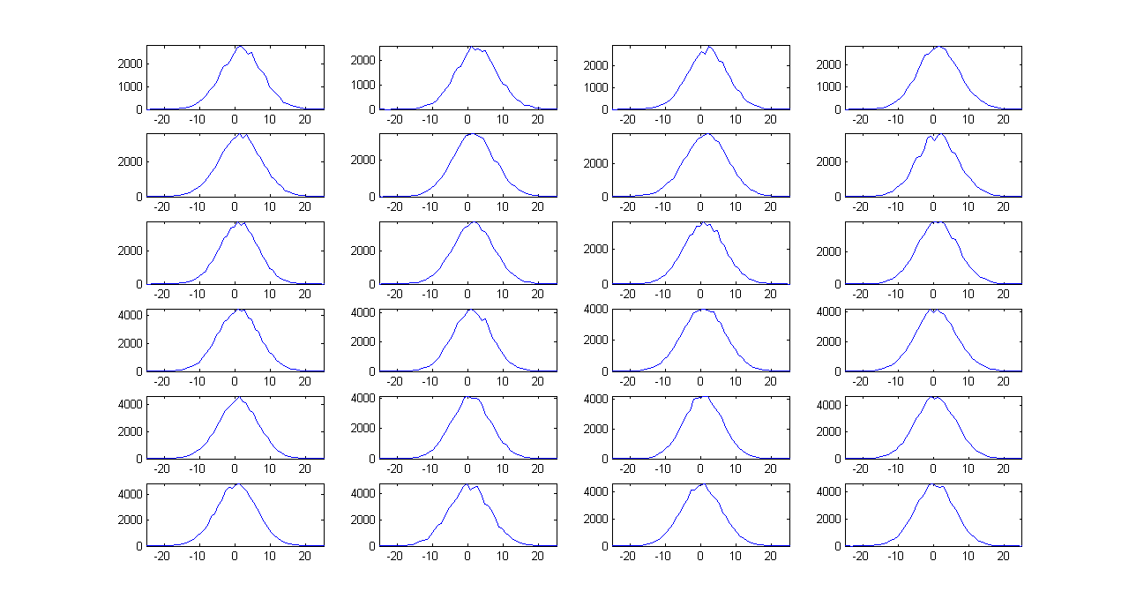

Graphical User Interface (GUI) design
System configuration database management
Analog gain settings
CFD settings
Energy window settings
Serial communication
Data acquisition
Energy data analysis
TDC calibration
Chinh Vu and Michael Malus also contributed to the GUI design
Crystal decoding
Delay compensation
Time analysis
Sinogram analysis
Flood map display
(for block detector)
Data analysis SW package
(currently in Matlab)
SSPM event display

Slide 44
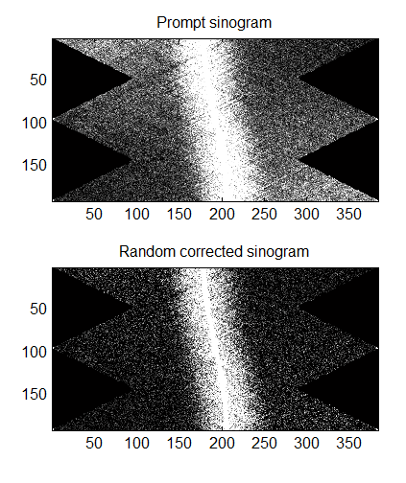
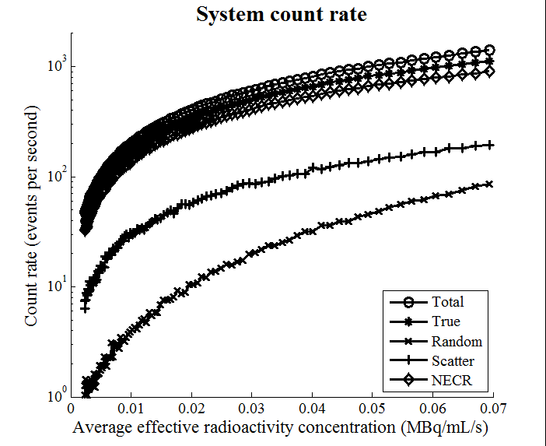
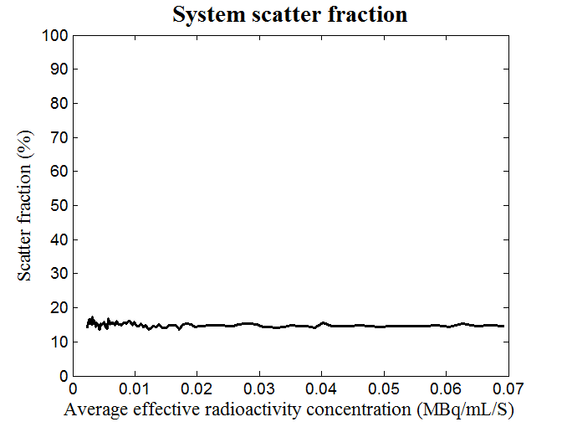
Graphical User Interface (GUI) design
System characterization

